Slide 1


Modelling and Simulation of Environmental Disturbances
(Module 5)
Dr Tristan Perez
Centre for Complex Dynamic Systems and Control (CDSC)
Prof. Thor I Fossen
Department of Engineering Cybernetics
One-day Tutorial, CAMS'07, Bol, Croatia

Slide 2



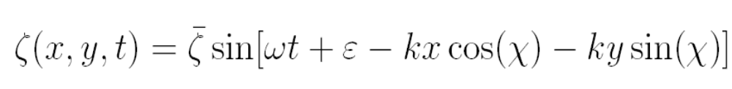

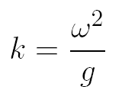
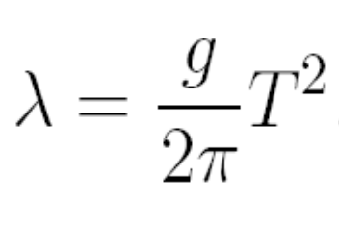
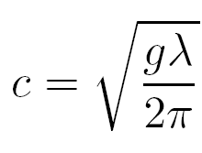






Regular waves in deep water
The sea surface elevation is described by:
where
Wave frequency
(rad/s)
Wave length
(m)
Phase velocity
(m/sec)
Wave number
(rad/m)
These expressions are only valid in deep water
, where h is the water depth.
One-day Tutorial, CAMS'07, Bol, Croatia

Slide 3
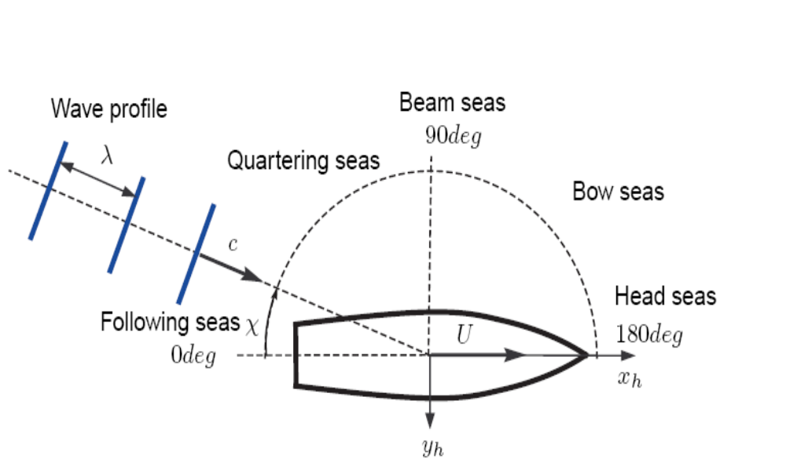
Sailing condition
The sailing condition of a vessel is given by its forward speed U and its encounter angle, i.e., the heading angle relative to the waves.
Encounter angle
One-day Tutorial, CAMS'07, Bol, Croatia

Slide 4
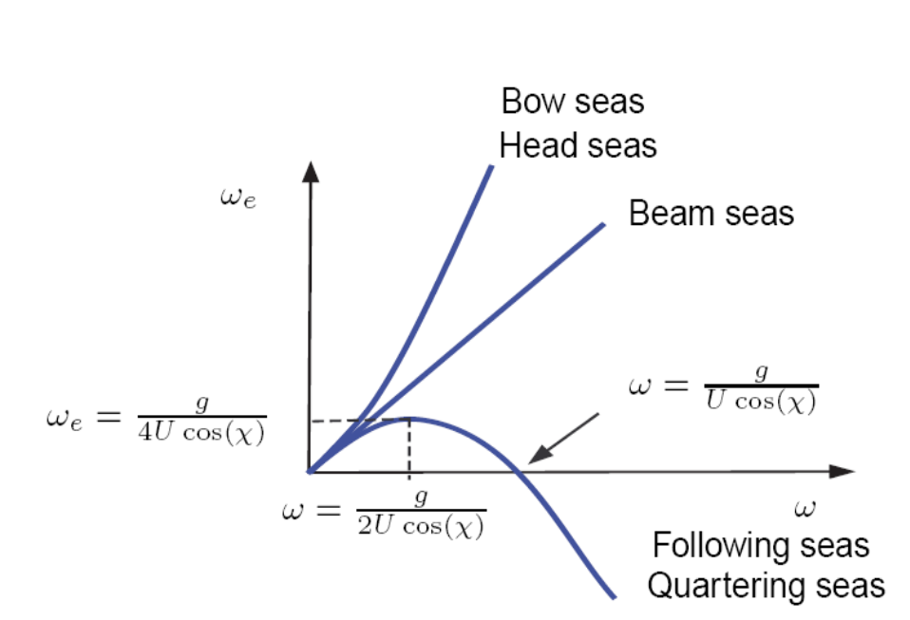
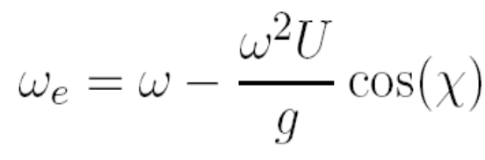
Encounter frequency
If the waves are observed from a reference frame that moves at a constant speed, the frequency observed is called Encounter Frequency.
This is a Doppler effect
Negative encounter frequency => vessel overtakes the waves
One-day Tutorial, CAMS'07, Bol, Croatia

Slide 5
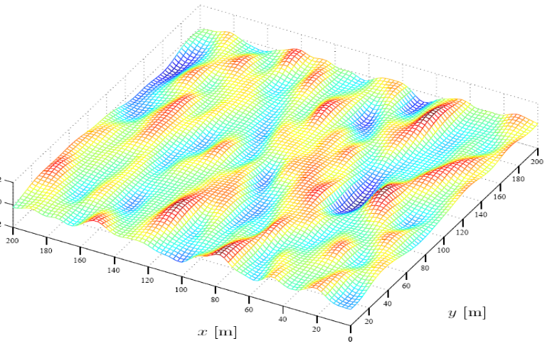
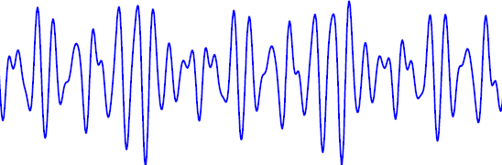
Ocean waves
Ocean waves present, in general, irregularity in time and space and cannot be predicted exactly: Stochastic Process.
ζ(x,y,0)
ζ(0,0,t)
t
One-day Tutorial, CAMS'07, Bol, Croatia

Slide 6
Stochastic sea description
In practice, it is assumed that the variations of a stochastic nature of the sea are much slower than the variations of the sea surface itself; Hence,
ζ(x, y, t) can be considered a realization of a stationary and homogeneous stochastic process.
For deep water waves, ζ(x, y, t) is further assumed Gaussian.
One-day Tutorial, CAMS'07, Bol, Croatia

Slide 7
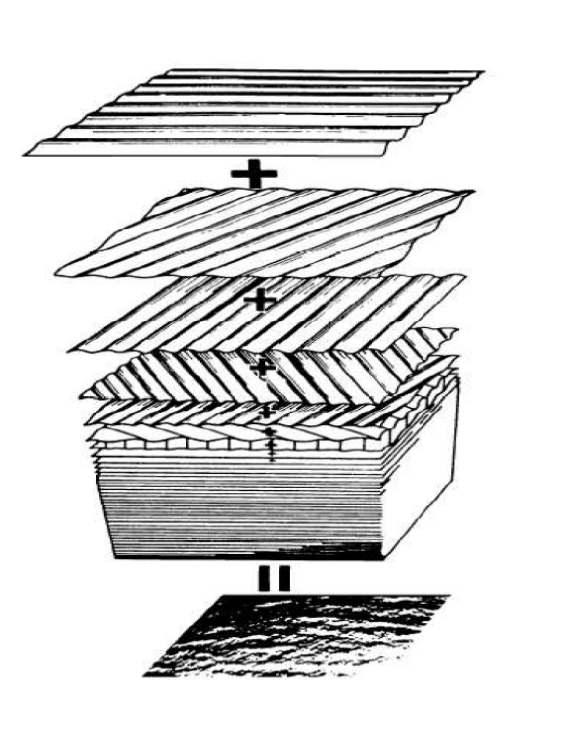

Gaussian waves
ζ(xo,yo,t)
p(ζ)
t
ζ
The elevation of the sea surface can be thought as being generated as the sum of many sinusoidal waves with different amplitudes, frequencies, and phases.
ζ(x,y,0)
(xo,yo)
One-day Tutorial, CAMS'07, Bol, Croatia

Slide 8
How good are these hypotheses?
From data collected at sea (Haverre & Moan, 1985), it can be stated that
For low and moderate seas (H1/3 < 4m), the sea can be considered stationary for periods over 20 min. For more severe sea states, stationarity can be questioned even for periods of 20 min.
For medium seas (4m < H1/3 < 8m), Gaussian models are still accurate, but deviations from Gaussianity slightly increase with the increasing severity of the sea state.
If the water is sufficiently deep, wave elevation can be consider Gaussian regardless of the sea state.
(H1/3 is the average of the highest one third of the waves recorded.)
One-day Tutorial, CAMS'07, Bol, Croatia

Slide 9
Random sea characterization
Under the Gaussianity assumption, the process is completely described by
Mean
Variance
The sea surface elevation is described relative to the mean free surface; therefore, the mean of the SP is zero.
The variance is described in terms of a sea power spectral density or sea spectrum.
One-day Tutorial, CAMS'07, Bol, Croatia

Slide 10
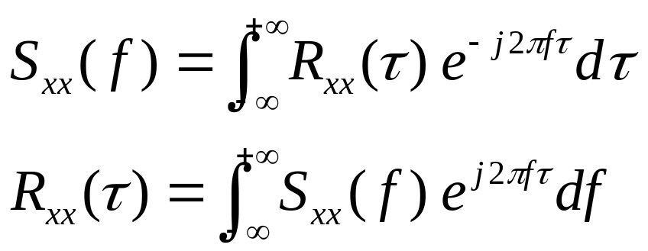
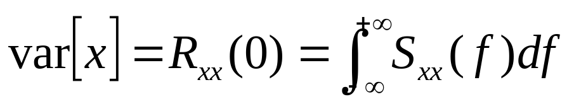
Power spectral density definition
If we use the frequency in Hz to define the FT, then
and
from which the name power spectral density follows.
This definition is common in the literature of electrical communications and signal processing.
One-day Tutorial, CAMS'07, Bol, Croatia

Slide 11
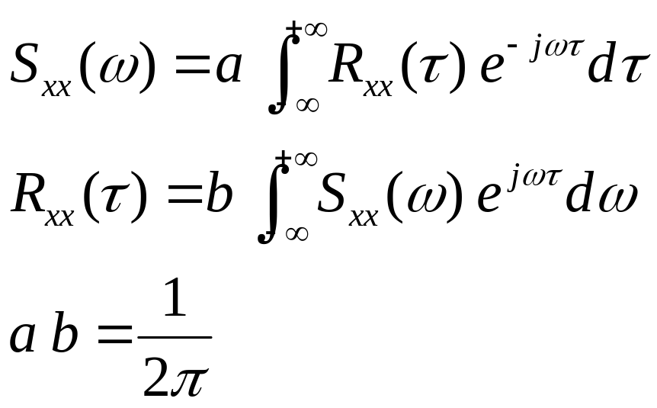
PSD alternative definition
When we use the circular frequency (rad/s) to define the FT,
We need to be careful on how we compute power!!!
One-day Tutorial, CAMS'07, Bol, Croatia

Slide 12
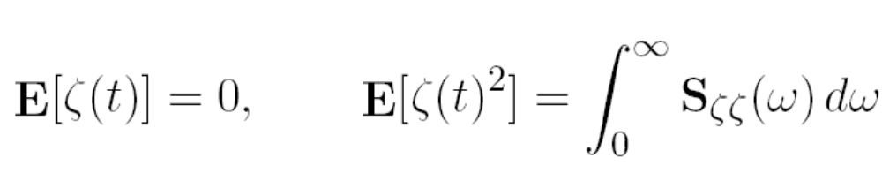
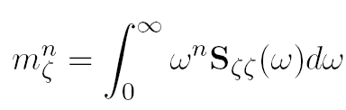
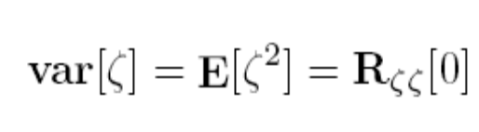
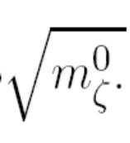


Random sea characterization
The spectral moments of order n are defined as:
Then the variance and standard deviation (RMS value) are
σ =
One-day Tutorial, CAMS'07, Bol, Croatia

Slide 13
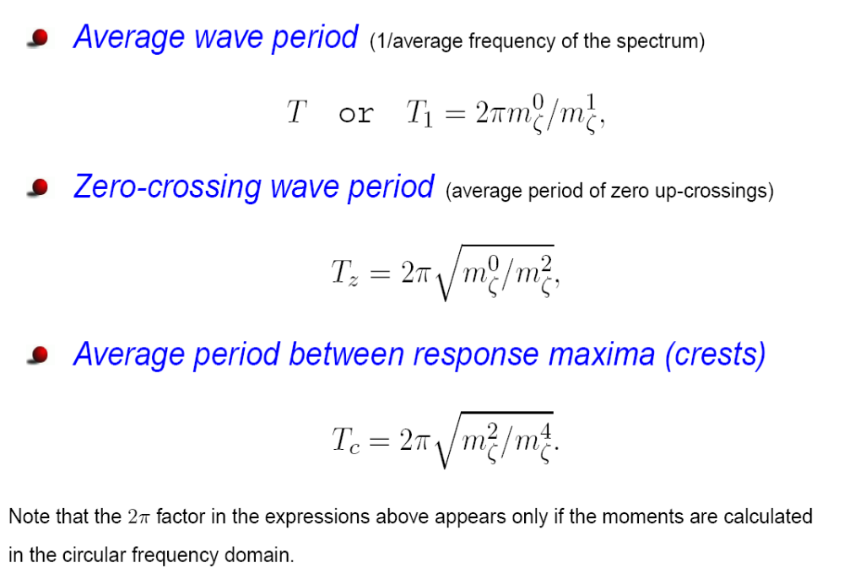
Statistics of wave period
One-day Tutorial, CAMS'07, Bol, Croatia

Slide 14
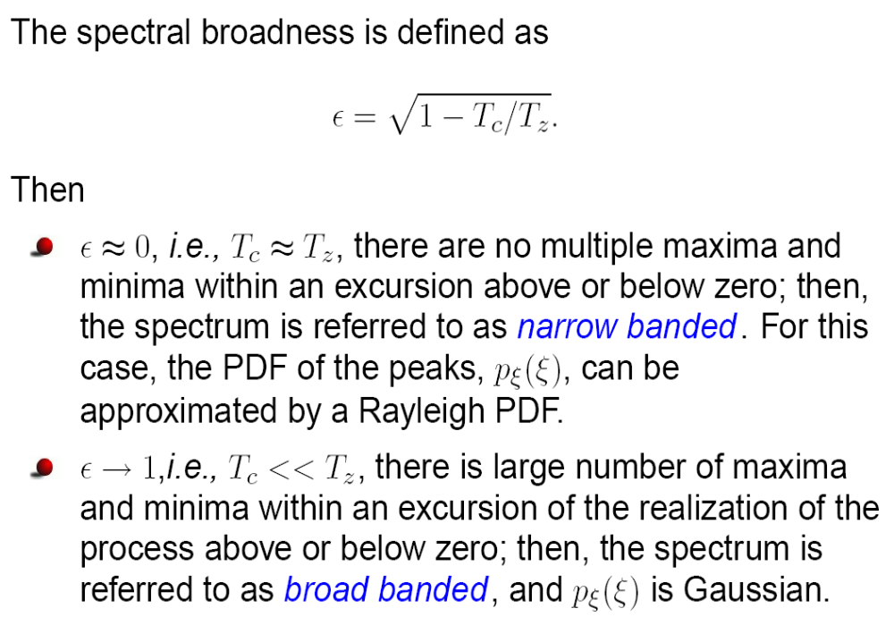
Narrow and wide banded processes
One-day Tutorial, CAMS'07, Bol, Croatia

Slide 15
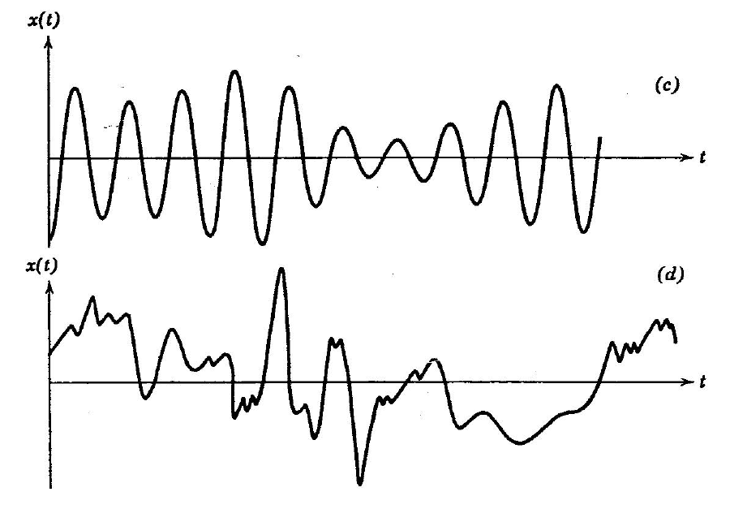
Example narrow and wide-banded
Narrow-banded signal
Wide-banded signal
One-day Tutorial, CAMS'07, Bol, Croatia

Slide 16
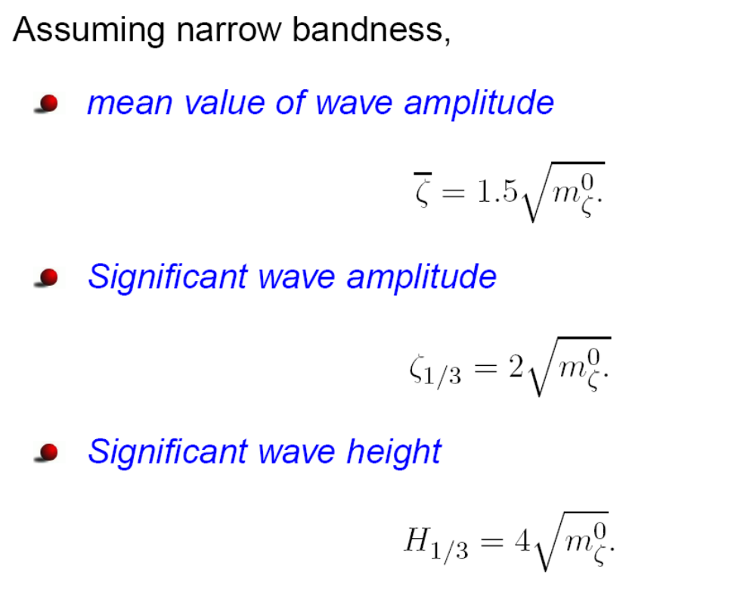
Statistics of wave height
One-day Tutorial, CAMS'07, Bol, Croatia

Slide 17
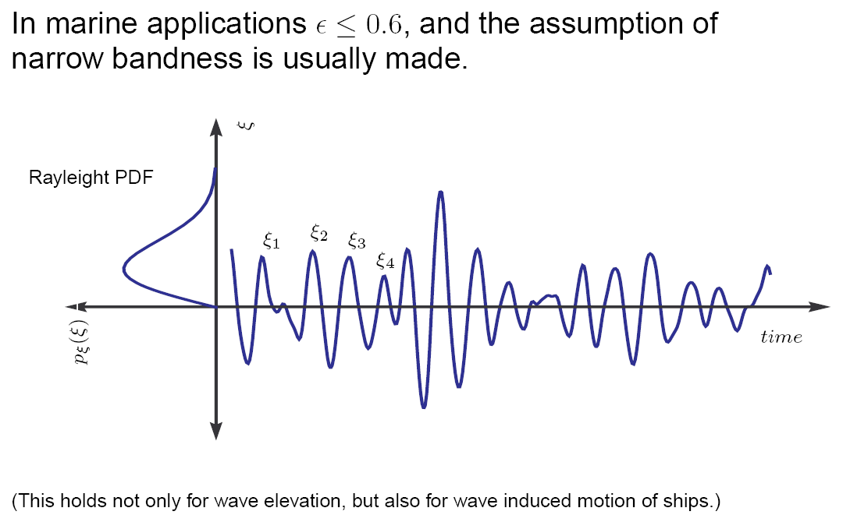
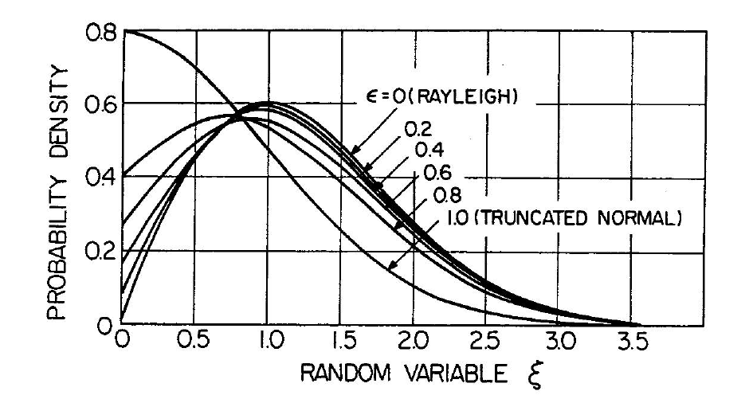
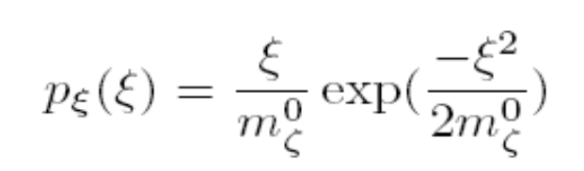
Statistics of Maxima
One-day Tutorial, CAMS'07, Bol, Croatia

Slide 18
Long- and short-crested Seas
After the wind has blown constantly for a certain period of time, the sea elevation can be assumed statistically stable. In this case, the sea is referred to as fully-developed.
If the irregularity of the observed waves are only in the dominant wind direction, so that there are mainly uni-directional wave crests with varying separation but remaining parallel to each other, the sea is referred to as a long-crested irregular sea.
When irregularities are apparent along the wave crests at right angles to the direction of the wind, the sea is referred to as short crested or confused sea.
One-day Tutorial, CAMS'07, Bol, Croatia

Slide 19
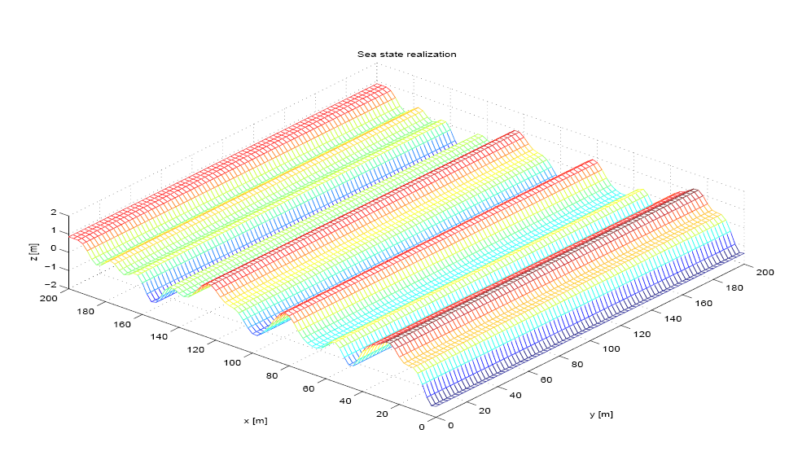
Long-crested Seas
One-day Tutorial, CAMS'07, Bol, Croatia

Slide 20
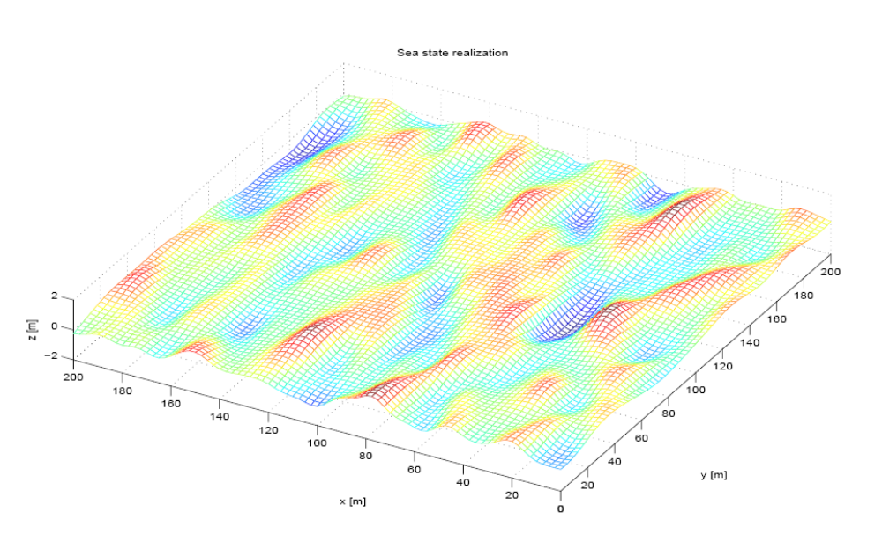
Short-crested Seas
One-day Tutorial, CAMS'07, Bol, Croatia

Slide 21
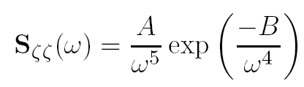
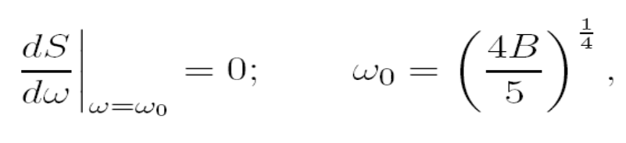
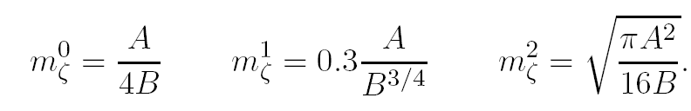
Idealised spectra Long-crested seas
In cases where no wave records are available, standard, idealized, formulae can be used. One family of idealized spectra is the Bretschneither family which was developed in early 1950s:
Modal frequency
Spectral moments
(This family can be used to represent rising and falling seas, as well as fully developed seas with no swell and unlimited fetch.)
One-day Tutorial, CAMS'07, Bol, Croatia

Slide 22
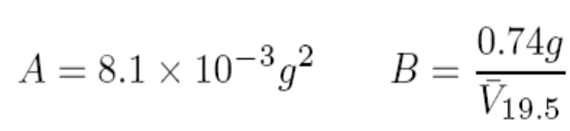
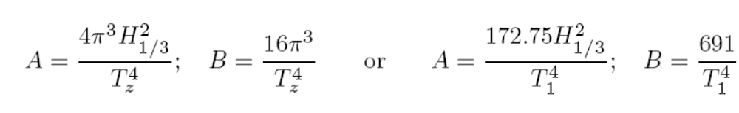
Idealised Spectra
In the 1960’s, the Pierson-Moskowitz family was developed to forecast storm waves at a single point in fully developed seas with no swell using wind data. This family relates the parameters A and B to the
average wind speed at 19.5m above the sea surface:
The ITTC recommends the use of the Modified Pierson-Moskowitz family; significant wave height and zero-crossing period or the average wave period is used:
One-day Tutorial, CAMS'07, Bol, Croatia

Slide 23
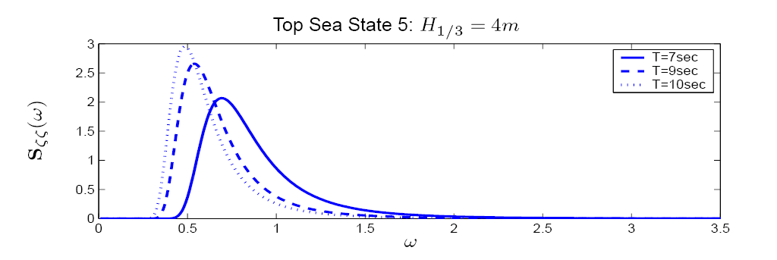
Example ITTC spectra
One-day Tutorial, CAMS'07, Bol, Croatia

Slide 24
Other Spectra seas
Other families:
The JONSWAP spectral family accounts for the case of limited fetch wind waves
The TMA spectral family is an extension of the JONSWAP for finite water depth,
The double-peak Torsethaugen spectral family accounts for both swell and wind waves,
The Ochi six-parameter spectral family can be fitted to almost any wave record (it could account for swell and wind waves.)
For further details see Ochi, K. (1998) Ocean Waves: The Stochastic Approach, Cambridge University Press. Ocean Tech. Series.
One-day Tutorial, CAMS'07, Bol, Croatia

Slide 25
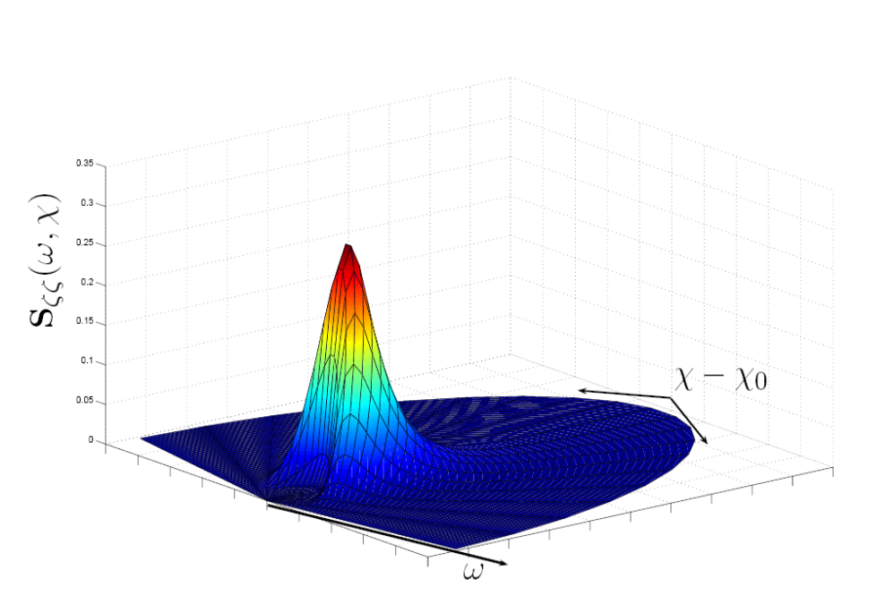
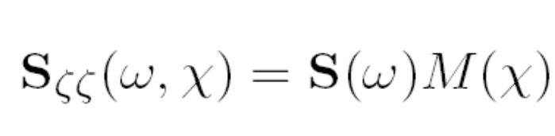

Spectra for Short-crested Seas
Directional spectra are more realistic and are very important to calculate loads on marine structures since the motion response depends highly on the encounter angle. For simulation, it is common to separate the directional spectrum as a product of two functions:
is the spreading function
One-day Tutorial, CAMS'07, Bol, Croatia

Slide 26
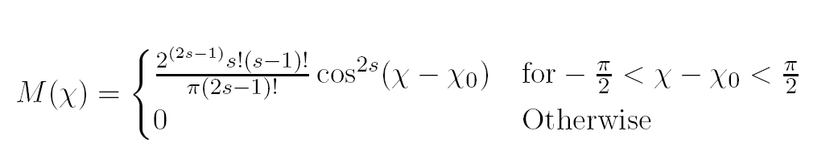
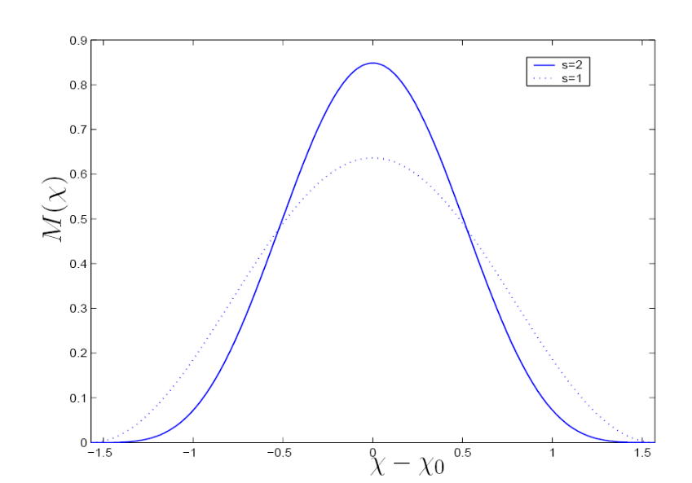
Spreading Function
where χ0 is the dominant wave propagation direction, and the values of s = 1, 2 are commonly used. See Lloyd (1989) for a more general form where |χ − χ0| < α; with α not necessarily equal to π/2
One-day Tutorial, CAMS'07, Bol, Croatia

Slide 27
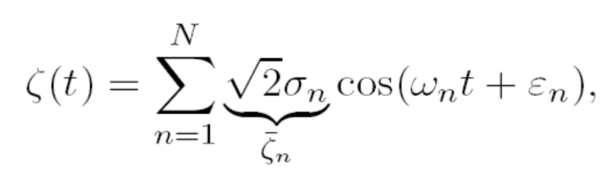
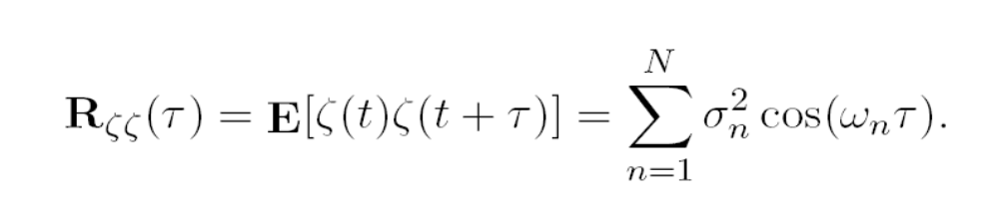
Time-domain Simulations
If ζ(t) is stationary and Gaussian on time interval [0, T], its realizations can be approximated to any degree of accuracy by
with N sufficiently large; where σ_{n} are constants and the phases ε_{n} are independent identically distributed random variables with uniform distribution in [0, 2π].
The autocorrelation is given by
One-day Tutorial, CAMS'07, Bol, Croatia

Slide 28
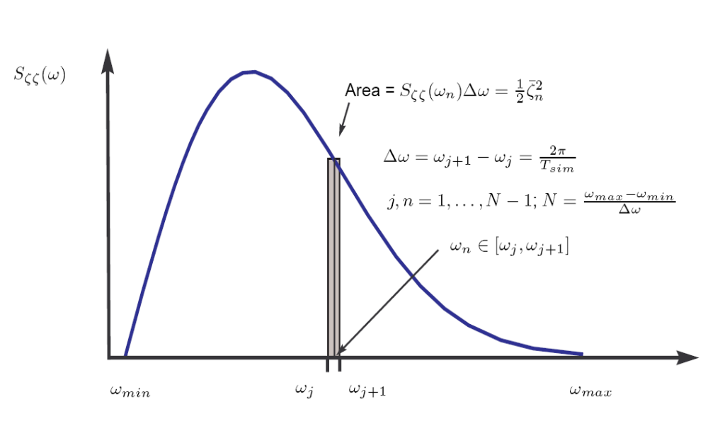
Time-domain Simulations
One-day Tutorial, CAMS'07, Bol, Croatia

Slide 29
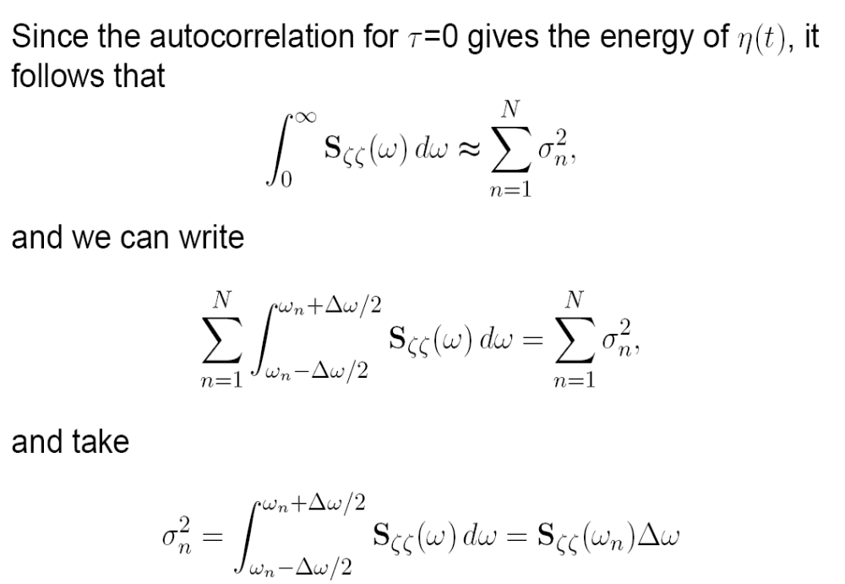
Why is it done this way?
One-day Tutorial, CAMS'07, Bol, Croatia

Slide 30
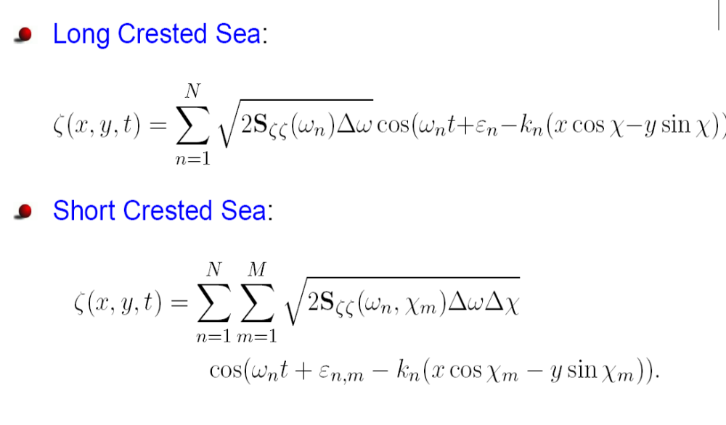
Formulae for Time-damin Simulations
One-day Tutorial, CAMS'07, Bol, Croatia

Slide 31
Wind
Wind is commonly divided in two components; a mean value and a fluctuating component, or gust.
The mean component decreases with the distance towards the ground or the surface of the ocean, whereas the gust is approximately constant with the distance to the ground or the surface of the ocean—boundary layer.
It is a 3D phenomenon, but in marine applications we restrict it to 2D, and velocities are considered only in the horizontal plane.
Wind is parameterized by the velocity U and the direction ψ. The direction is taken with respect to the North-East.
Note that, in general, the direction of the wind is the direction from where the wind is coming from, e.g., a SE wind blows from the SE towards NW.
One-day Tutorial, CAMS'07, Bol, Croatia

Slide 32
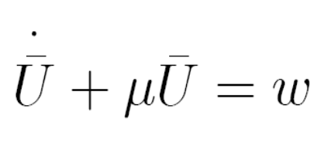
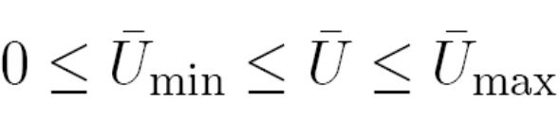
Wind Mean-velocity Component
Slowly-varying fluctuations in the mean wind velocity can be modeled by a 1st order Gauss-Markov Process:
where w is Gaussian white noise and μ ≥ 0 is a constant.
The magnitude of the velocity should be restricted by saturation elements
One-day Tutorial, CAMS'07, Bol, Croatia

Slide 33
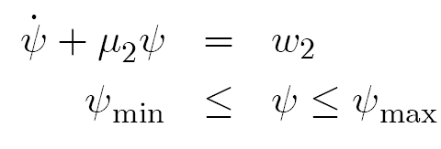
Wind Mean-direction component
Slowly-varying fluctuations in the mean wind direction can also be implemented by a 1st order Gauss-Markov Process (Sorensen, 2005):
The direction is taken with respect to the (n-frame).
NOTE: This direction is often the direction from where the wind is blowing: North-East (NE) wind blows from the NE
One-day Tutorial, CAMS'07, Bol, Croatia

Slide 34
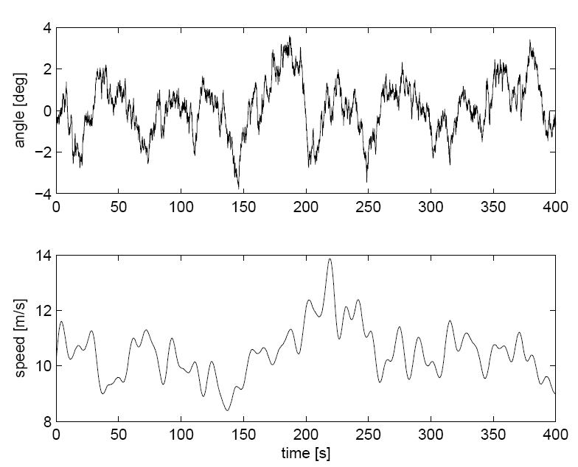
Wind velocity and direction
Sorensen, (2005)
One-day Tutorial, CAMS'07, Bol, Croatia

Slide 35
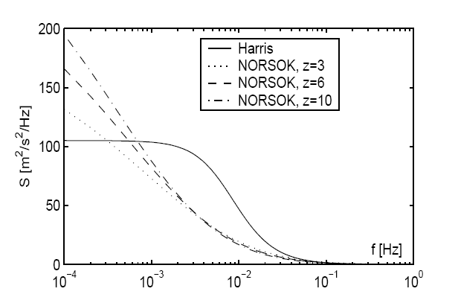
Wind Gust
The wind gust is model as a realization of a stochastic process with a particular spectrum (Sorensen, 2005).
One-day Tutorial, CAMS'07, Bol, Croatia

Slide 36
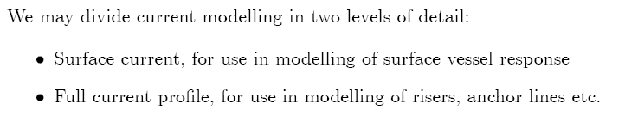



Current
Surface Current
Current velocity magnitude:
Current direction:
The direction is taken with respect to the (n-frame). NOTE: This direction is the direction to where the current flows : North-East (NE) current flow towards the NE. (This is different from the convention for wind)
One-day Tutorial, CAMS'07, Bol, Croatia

Slide 37
References
Perez, T. (2005) Ship Motion Control. Springer.
Ochi, M. (2005) Ocean Waves: the stochastic approach. Cambridge University Press.
Sorensen, A.J. (2005) “Marine Cybernetics.” Lecture notes, Dept. of Marine Technology NTNU, NORWAY.
One-day Tutorial, CAMS'07, Bol, Croatia

